Slide 1
Assembly instruction

Slide 2
FreiBox Active Commutator V2: Overview
2
STL files
1
CommutatorBase
5
4
3
Component list
PulleyLinker
Linker_Part1
Linker_Part2
Detector_Part1
Detector _Part2

Slide 3
Instruction overview
Before sssembling the commutator, please read below!!
Print, collect all the parts and build the electronic circuit
Before final assembly, you must first build:
The pulley linker part (nuts insertion + pulley gluing)
The ring detector (capacitor and connector to be soldered to the hall sensor + gluing to the Detector _Part1 and Part2)
Solder the 2x U.FL (male) connectors to the slip ring and the miniscope cable end. Secure them with cement or epoxy.
Solder the miniscope cable to the slip ring
Once the previous steps have been completed, you can assemble all the parts (except the Detector_Part2).
After defining the position of the magnet, as well as the its polarity *, you can the superglue the magnet onto the miniscope cable. The magnet must be placed in the center of the hall detector centers.
/!\ *To avoid an inversion of the logic detection, the magnet polarity must to be checked first! The magnet must to be glue on its ‘south’ while its ‘north’ side must face the hall sensors (to get a positive signal)
Weight/Ballast the miniscope (or neuropixel) cable with M5/M6 nuts. This stabilizes the movement of the magnet without changing the weight on the mouse
Connect your cable to the electronic circuit. Load the Arduino code and test it.
You are ready to image!

Slide 4
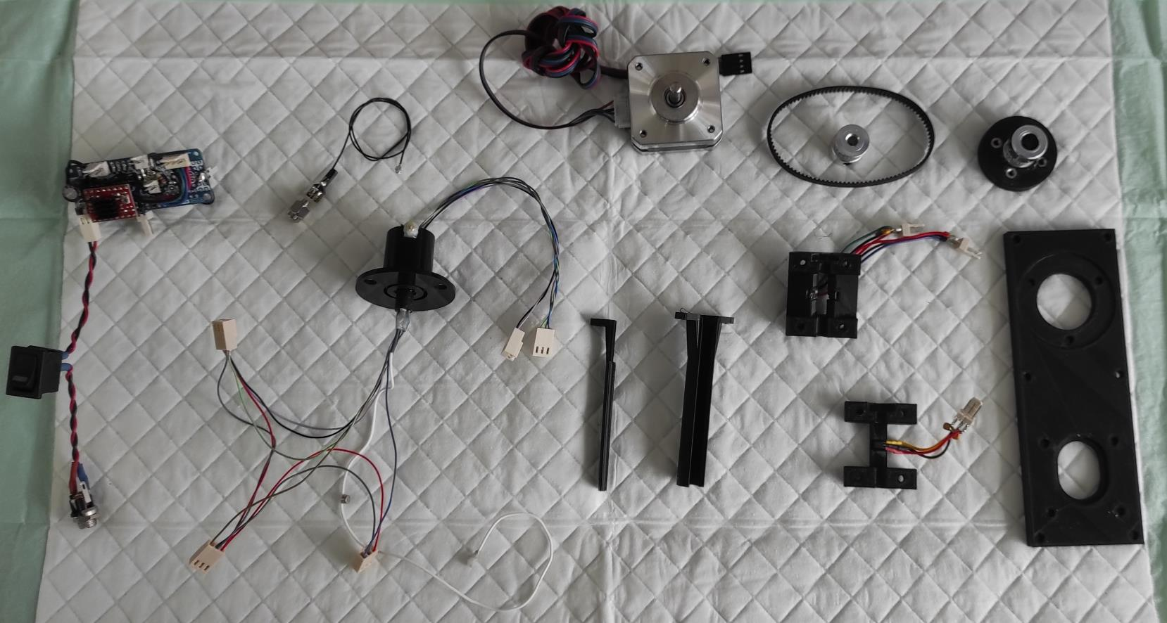
Collect all parts before the assembling
Assembled slip ring
CommutatorBase
Detector _Part2
Linker_Part1
Linker_Part2
Detector_Part1
Electronic
Circuit + Nano every
Nema
step motor
PulleyLinker
U.FL (Female) to SMA cable
(to connect to the DAC)
Timing pulley
And timing belt

Slide 5
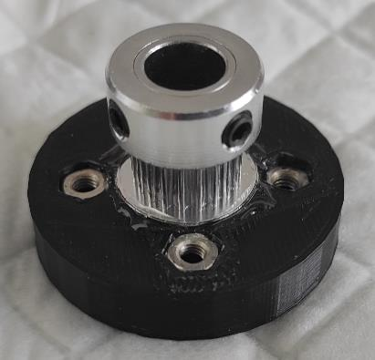
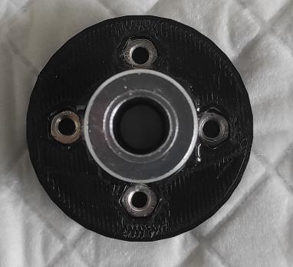
Assembling of the pulley linker
First insert the M3 nut into the 4 corresponding slots of the linker pulley
Then, glue the pulley linker to the with the GT2 timing pulley 8mm bore with epoxy. Avoid getting glue in the bore or in the nuts.

Slide 6
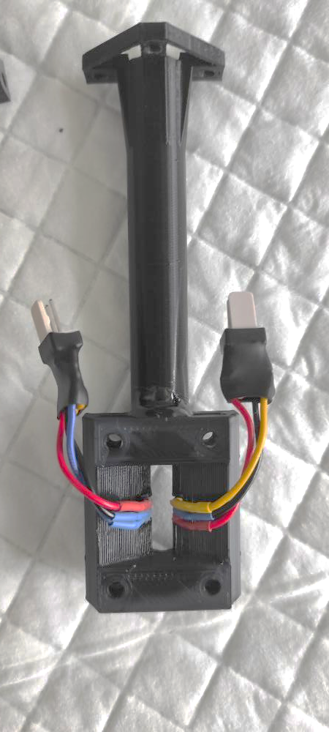
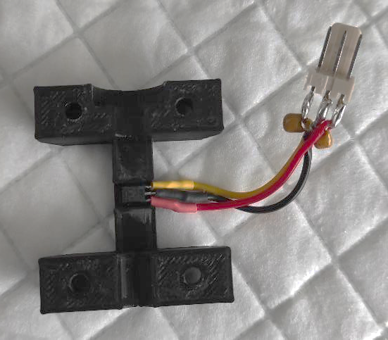
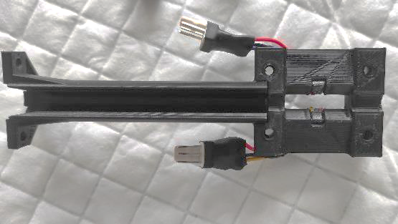
The ring detector
1. Solder the capacitor to the hall sensor as shown
2. Stick the Hall sensor to the Ring Detector Part1 and Part2 with superglue
3. Using epoxy, glue the Detector_Part1 to the Linker_Part1
4. Insert the nuts into their corresponding slots (see arrows)
Epoxy
Signal/GND/5V

Slide 7
Assembled slip ring

Slide 8
Assembled slip ring
Extended Data Figure 4-1
10.1523/ENEURO.0469-22.2023
The signals from the Miniscope (GND and 5V) and the Hall sensors (GND, 5V and the 3 analog signals from the hall sensors) are relayed via a slip ring and send to the Arduino.
We decided to use the U.FL connector to keep the possibility of connecting another miniscope or changing a possible broken cable easily. However, we strongly advise avoiding repetitive connection/disconnection of the U.FL connectors. As for the miniscopes, they are a little fragile. Instead you should have a commutator for each miniscope/setup since the price is cheap !

Slide 9
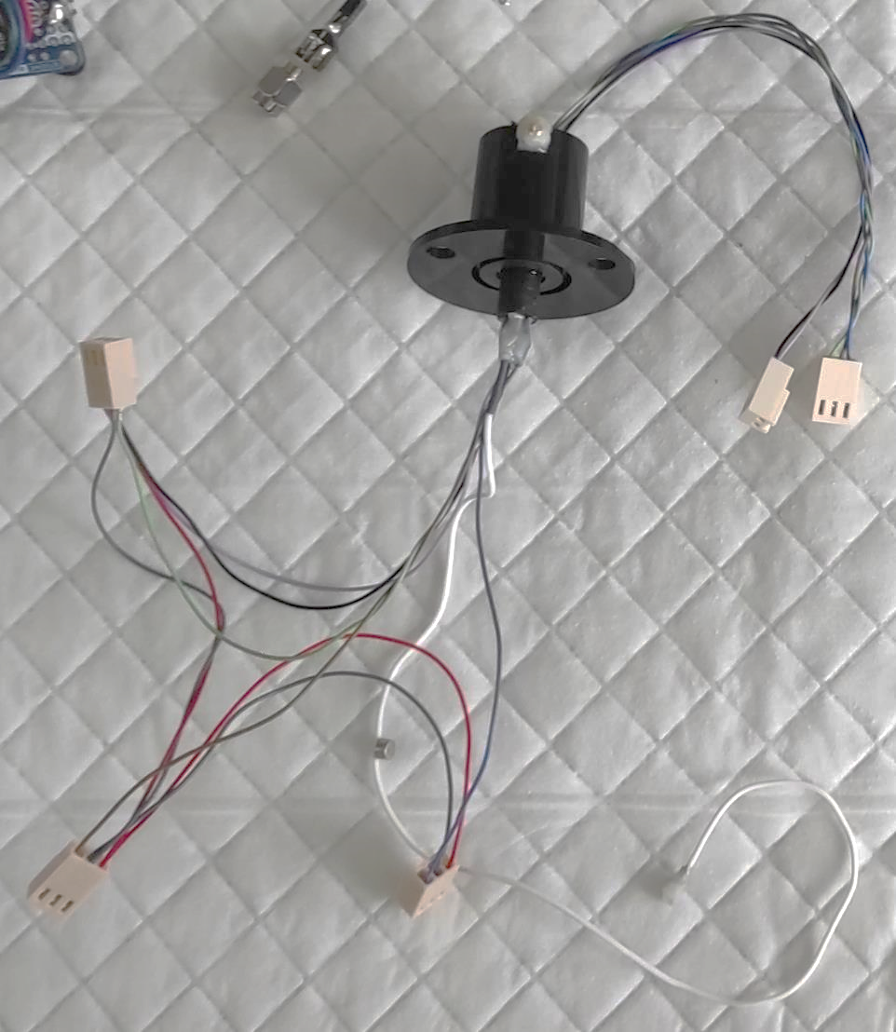
Assembled slip ring
U.FL
(Male)
1. Miniscope cable soldering to slip ring
/!\ Minimize the length of the cable coming from the slip ring
2. U.FL soldering to Slip ring
3. U.FL soldering to miniscope cable
4. Check the connectivity !! A shortcut between the 2 miniscope cables can damage the DAQ!!!
5. Fixing with epoxy/cement
/!\ Minimize the Epoxy to ensure that the 8mm bore pulley linker is still fitting around the slip ring rotor (* on the photo).
Connectors for the
3 hall sensors
(GND, 5v and signal)
*
<8mm
GND
and 5v
4mm
magnet
3 analogic
signals
U.FL
(Male)
Miniscope cable

Slide 10
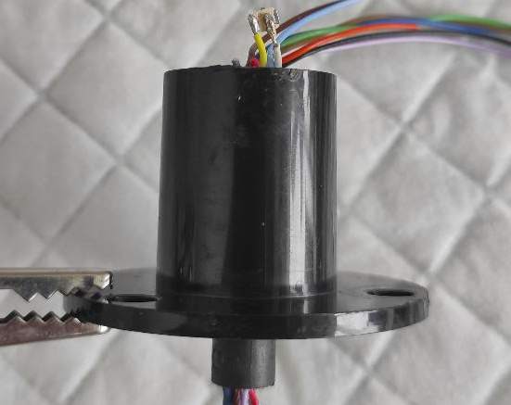
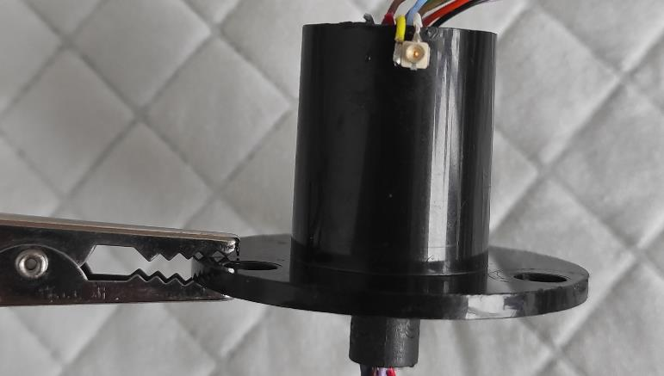
U.FL soldering to the Slip ring
GND
Signal

Slide 11
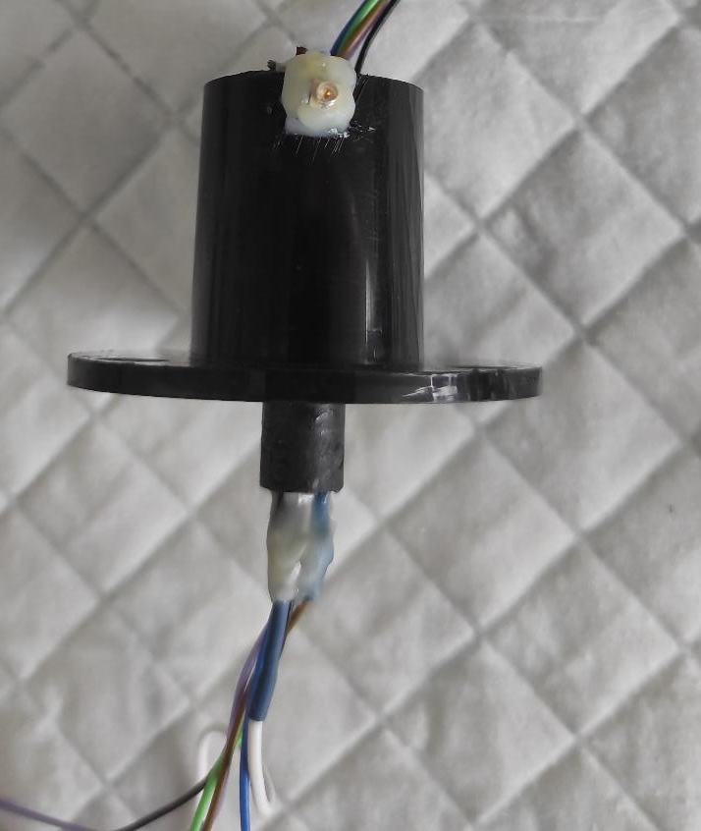
After having testing the U.FL connectivity, secure the U.FL connector to the slip ring with Epoxy/Cement
We also advice to glue the miniscope cable
with epoxy as shown
*
/!\ Minimize the Epoxy to ensure that the 8mm bore pulley linker is still fitting around the slip ring rotor (* on the photo).
<8mm

Slide 12
Pre-assembling

Slide 13
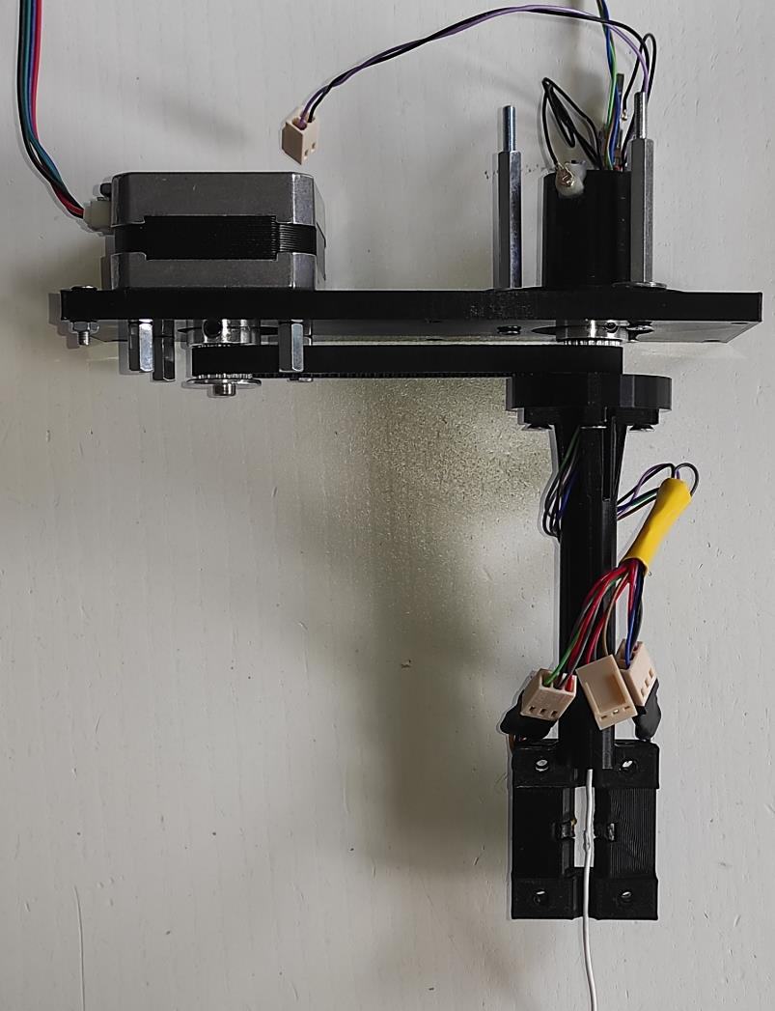
Pre-assembling
Connect the timing pulleys to the slip ring and the motor
Secure the slip ring, insert the timing belt and place the motor
Insert Nuts in the Ring detector

Slide 14
Magnet positioning on the cable
1. Identify magnet orientation
2. Glue the magnet to the cable

Slide 15
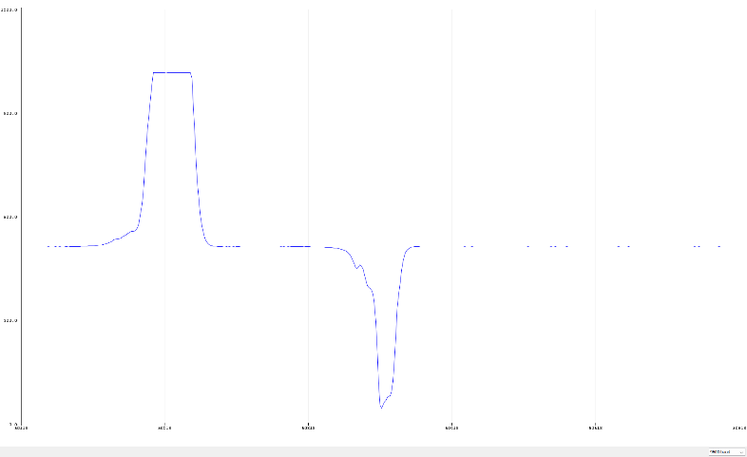
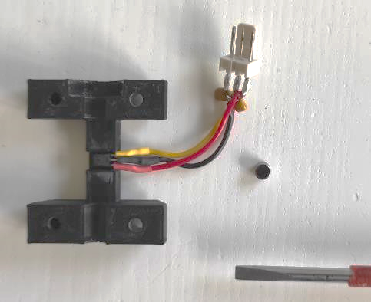
Identify the North/Pole pole
North pole
Facing the hall sensor
Hall sensor analog signal
Since the voltage output of the HAL830 Hall sensor is sensitive to the direction of the magnetic field (see on right figure), it is important to identify the orientation of the magnet before sticking it.
To identify magnet orientation:
Connect a hall sensor to an Arduino(5v, Gnd and signal) and record its output signal
Mark one side of the magnet with a marker
Attached the Magnet to a screwdriver
Identify the magnet pole (see after)
baseline
South pole
facing the hall sensor

Slide 16
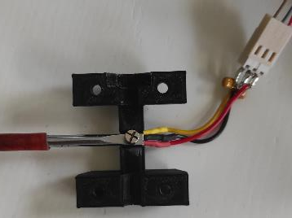
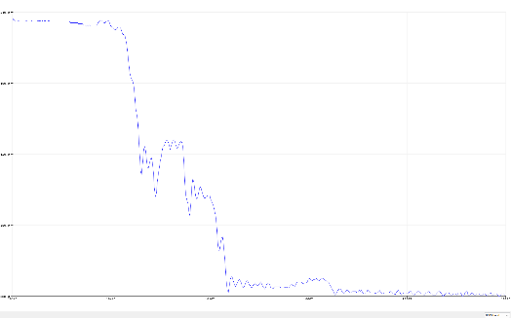
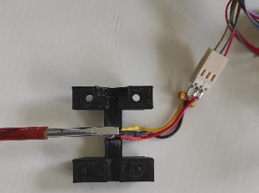
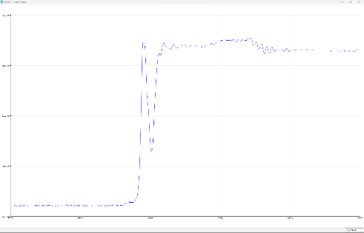
Identify the North/Pole pole -2
baseline
The unmarked side is the south
While the marked side is the north
baseline

Slide 17
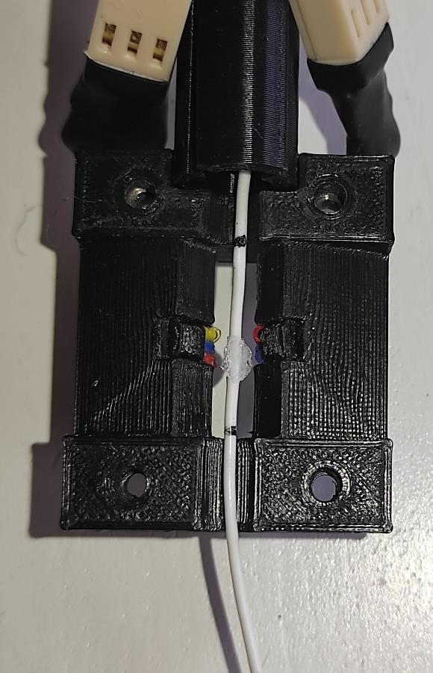
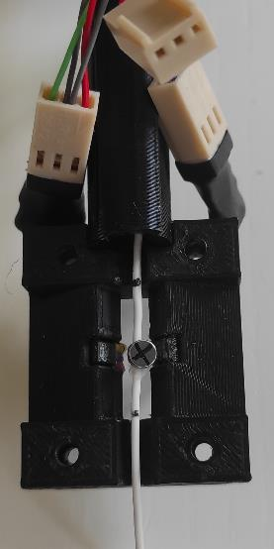
Magnet positioning on the cable
Pull on the miniscope cable and mark it to identify the magnet position (red arrow)
Glue the magnet and be sure that the north pole is facing the hall sensors during cable rotation (marked with a cross) :

Slide 18
Final assembly

Slide 19
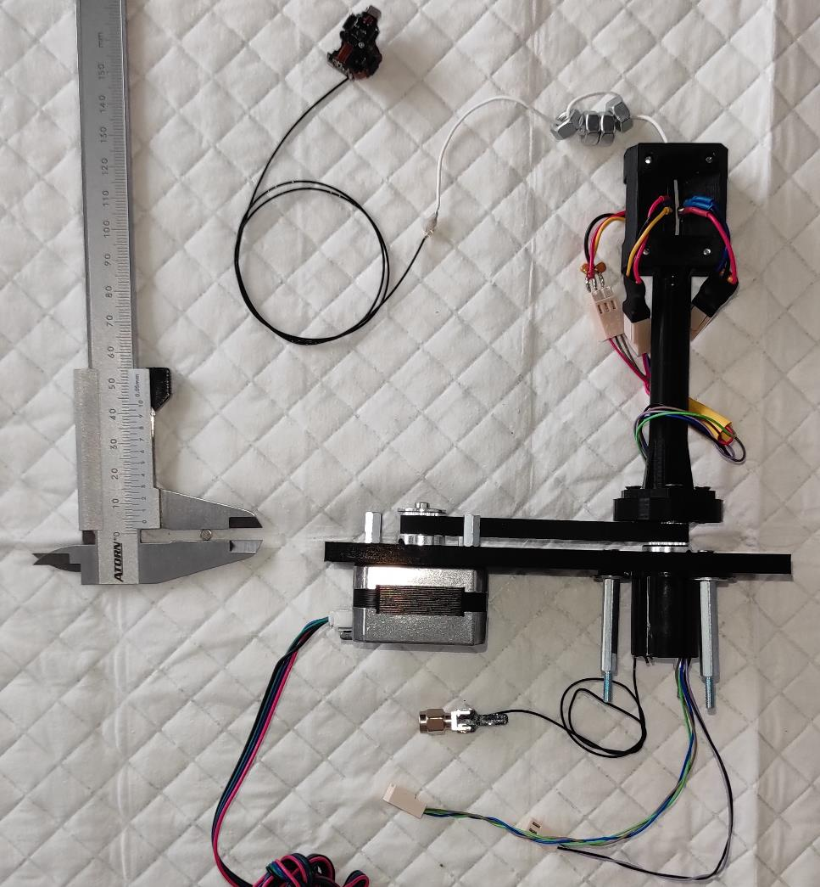
Final assembly
The nuts are used to ‘ballast’ the miniscope cable.
Particularly useful for other flexible cables such as the neuropixel cable

Slide 20
Electronic circuit

Slide 21
Electronic circuit
Extended Data Figure 4-1
10.1523/ENEURO.0469-22.2023
G–I, To build the FreiBox commutator, the 3 Hall sensors (G) and a motor driver card (H) are connected to the step motor and the Arduino; the signals from the Miniscope and the Hall sensors are relayed via a slip ring (I).

Slide 22
Electronic circuit
If you don’t want to solder the circuit yourself, you can use Arduino motor shield such as:
For Arduino Nano: Ks0152 keyestudio CNC Shield V4
For Arduino Uno or Mega: Joy-it ARD-CNC-Kit1 Motortreiber

